Slide 1
Understanding the Supplemental Poverty Measure
Trudi Renwick & Liana Fox
U.S. Census Bureau

Slide 2
The views expressed in this research, including those related to statistical, methodological, technical, or operational issues, are solely those of the author and do not necessarily reflect the official positions or policies of the Census Bureau. The author accepts responsibility for all errors. This presentation is released to inform interested parties of ongoing research and to encourage discussion of work in progress. This presentation reports the results of research and analysis undertaken by Census Bureau staff. It has undergone more limited review than official publications.

Slide 3
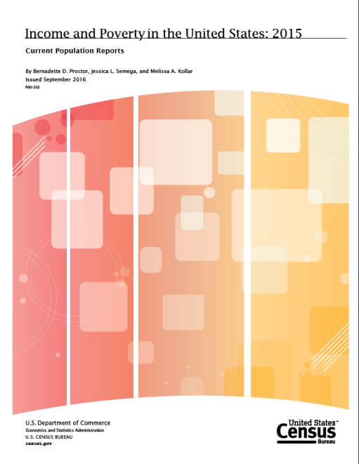
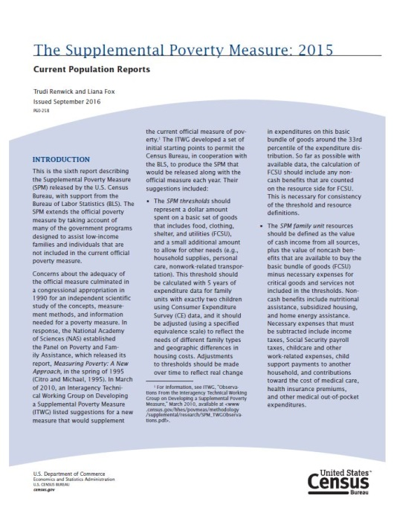
Official Poverty and Supplemental Poverty Estimates for 2015 released in September 2016
Highlights
The official poverty rate in 2015 was 13.5 percent, down 1.2 percentage points from 2014. In 2015, there were 43.1 million people in poverty, 3.5 million fewer than in 2014.
The Supplemental Poverty Measure (SPM) rate in 2015 was 14.3 percent, 1 percentage point lower than the SPM estimate for 2014.

Slide 4
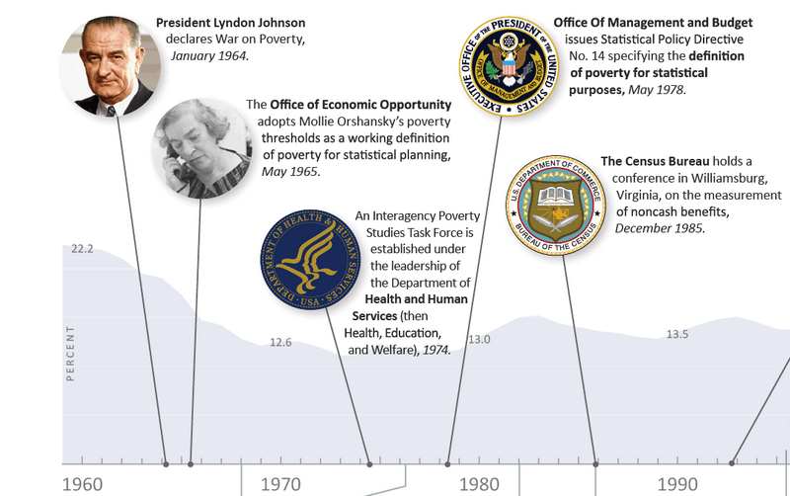
First Census Bureau Report on Poverty: 1967

Slide 5
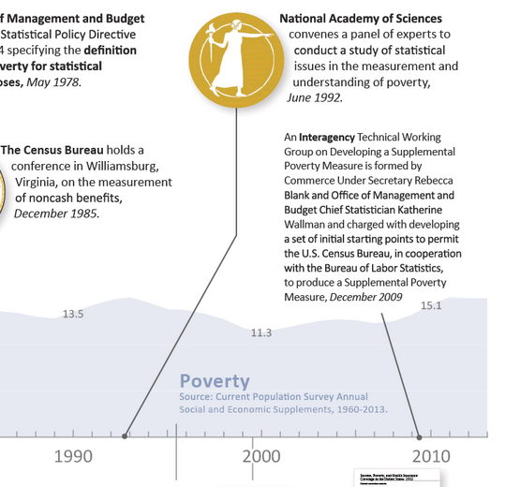
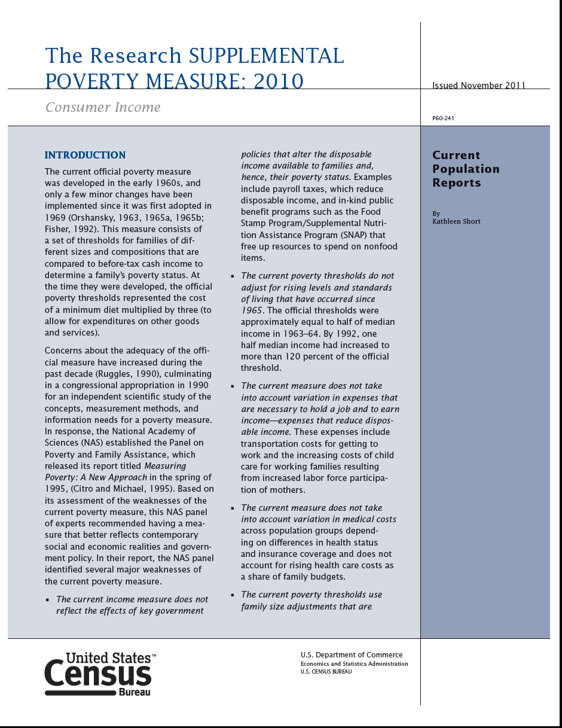
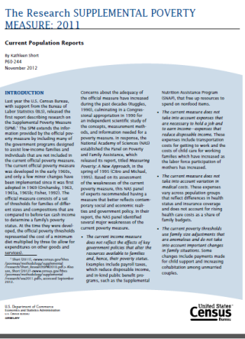
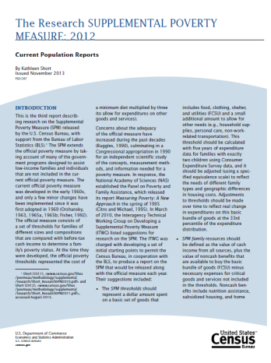
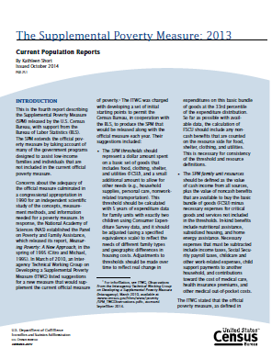
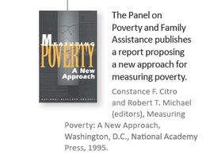
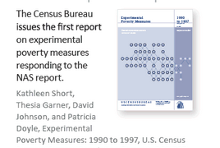

Slide 6
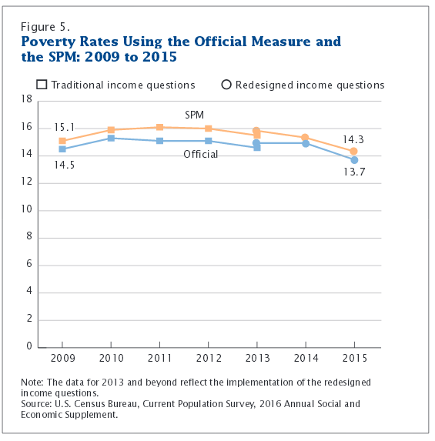
Supplemental Poverty Measure (SPM)
Observations from the Interagency Technical Working Group (ITWG) - March 2, 2010
Will not replace the official poverty measure
Will not be used for resource allocation or program eligibility
Census Bureau and BLS responsible for improving and updating the measure
Continued research and improvement
Based on National Academy of Sciences expert panel recommendations in Measuring Poverty: A New Approach (Citro and Michael,1995)

Slide 7
Criticisms of the Official Poverty Measure
The official measure does not account for:
Provision of in-kind benefits
Necessary expenses (taxes, health care, work)
Changes in family or household structure
Higher standards and levels of living since 1965
Geographic price differences among regions

Slide 8
Poverty Measure Concepts: Official vs Supplemental Poverty Measure
 | Official | SPM
Measurement units
Poverty threshold
Threshold adjustments
Updating thresholds
Resource measure

Slide 9
Poverty Measure Concepts: Official vs Supplemental Poverty Measure
 | Official | SPM
Measurement units | Family only | OPM plus unmarried partners, unrelated children and foster children
Poverty threshold
Threshold adjustments
Updating thresholds
Resource measure
Notes:
Poverty thresholds are the dollar amounts used to determine poverty status.
Poverty thresholds were originally derived in 1963-1964, based on
U.S. Department of Agriculture food budgets designed for families under economic stress.
Data about what portion of their income families spent on food to estimate total income
Equivalence scale calculate total income for different family size and compositions
Thresholds vary according to family size, number of related children, and age of householder
The same thresholds are used throughout the United States (do not vary geographically).
Updated annually for inflation using the Consumer Price Index for All Urban Consumers (CPI-U).

Slide 10
Poverty Measure Concepts: Official vs Supplemental Poverty Measure
 | Official | SPM
Measurement units | Family only | OPM plus unmarried partners, unrelated children and foster children
Poverty threshold | 3 times minimally adequate food diet in 1960s | 30th-36th percentile of expenditures on food, clothing, shelter and utilities (+ 20%)
Threshold adjustments
Updating thresholds
Resource measure
Notes:
Poverty thresholds are the dollar amounts used to determine poverty status.
Poverty thresholds were originally derived in 1963-1964, based on
U.S. Department of Agriculture food budgets designed for families under economic stress.
Data about what portion of their income families spent on food to estimate total income
Equivalence scale calculate total income for different family size and compositions
Thresholds vary according to family size, number of related children, and age of householder
The same thresholds are used throughout the United States (do not vary geographically).
Updated annually for inflation using the Consumer Price Index for All Urban Consumers (CPI-U).

Slide 11
Poverty Measure Concepts: Official vs Supplemental Poverty Measure
 | Official | SPM
Measurement units | Family only | OPM plus unmarried partners, unrelated children and foster children
Poverty threshold | 3 times minimally adequate food diet in 1960s | 30th-36th percentile of expenditures on food, clothing, shelter and utilities (+ 20%)
Threshold adjustments | Vary by family size, composition and age of householder | Geographic adjustments for differences in housing costs and equivalence scale for family size and comp. Three separate thresholds by housing status
Updating thresholds
Resource measure
Notes:
Poverty thresholds are the dollar amounts used to determine poverty status.
Poverty thresholds were originally derived in 1963-1964, based on
U.S. Department of Agriculture food budgets designed for families under economic stress.
Data about what portion of their income families spent on food to estimate total income
Equivalence scale calculate total income for different family size and compositions
Thresholds vary according to family size, number of related children, and age of householder
The same thresholds are used throughout the United States (do not vary geographically).
Updated annually for inflation using the Consumer Price Index for All Urban Consumers (CPI-U).

Slide 12
Poverty Measure Concepts: Official vs Supplemental Poverty Measure
 | Official | SPM
Measurement units | Family only | OPM plus unmarried partners, unrelated children and foster children
Poverty threshold | 3 times minimally adequate food diet in 1960s | 30th-36th percentile of expenditures on food, clothing, shelter and utilities (+ 20%)
Threshold adjustments | Vary by family size, composition and age of householder | Geographic adjustments for differences in housing costs and equivalence scale for family size and comp. Three separate thresholds by housing status
Updating thresholds | Consumer Price Index (CPI-U) | Five year moving avg. of expenditures
Resource measure
Notes:
Poverty thresholds are the dollar amounts used to determine poverty status.
Poverty thresholds were originally derived in 1963-1964, based on
U.S. Department of Agriculture food budgets designed for families under economic stress.
Data about what portion of their income families spent on food to estimate total income
Equivalence scale calculate total income for different family size and compositions
Thresholds vary according to family size, number of related children, and age of householder
The same thresholds are used throughout the United States (do not vary geographically).
Updated annually for inflation using the Consumer Price Index for All Urban Consumers (CPI-U).

Slide 13
Poverty Measure Concepts: Official vs Supplemental Poverty Measure
 | Official | SPM
Measurement units | Family only | OPM plus unmarried partners, unrelated children and foster children
Poverty threshold | 3 times minimally adequate food diet in 1960s | 30th-36th percentile of expenditures on food, clothing, shelter and utilities (+ 20%)
Threshold adjustments | Vary by family size, composition and age of householder | Geographic adjustments for differences in housing costs and equivalence scale for family size and comp. Three separate thresholds by housing status
Updating thresholds | Consumer Price Index (CPI-U) | Five year moving avg. of expenditures
Resource measure | Gross before-tax cash income | Sum of cash income, PLUS: in-kind benefits (SNAP, LIHEAP, WIC, Housing subsidies) MINUS: Taxes, child support paid, work expenses (including child care), medical out-of-pocket expenses

Slide 14

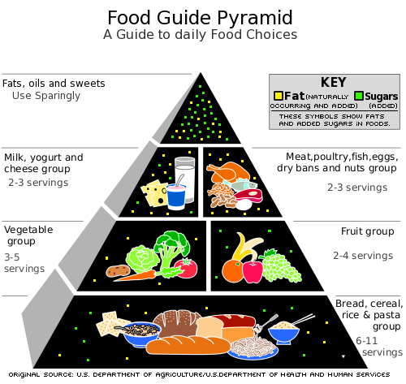
How to Determine Poverty Status
All family members have the same poverty status.
For individuals who do not live with family members, their individual resources are compared with the appropriate threshold.
Resources
Needs

Slide 15
How to Determine Poverty Status (cont.)
For example:
Family of three with one child under 18 years in 2015 had cash income of $20,000 (AZ metro, renter).
Net taxes/EITC: $1,701
WIC: $1,038
Work/Childcare Expenses: -$2,463
SPM Resources: $20,276
Official threshold is $19,078. SPM threshold is $21,303.
Official: $20,000>$19,078 so family is considered “above poverty level”.
SPM: $20,276<$21,303 so family is considered poor by the SPM.

Slide 16
Comparison of SPM and Official Poverty Estimates by Age: 2015
Percent
Official*
SPM
*Includes unrelated individuals under age 15.
Source: U.S. Census Bureau, Current Population Survey, 2015 Annual Social and Economic Supplement.
www.census.gov/library/publications/2015/demo/p60-254.html

Slide 17
Change in Number of People in Poverty After Including Each Element: 2015 (In millions)
11.3
Source: U.S. Census Bureau, Current Population Survey, 2016 Annual Social and Economic Supplement.

Slide 18
Change in Number of People in Poverty After Including Each Element: 2015 (In millions)
Social Security
11.3
Source: U.S. Census Bureau, Current Population Survey, 2016 Annual Social and Economic Supplement.

Slide 19
Change in Number of People in Poverty After Including Each Element: 2015 (In millions)
Refundable tax credits
11.3
Source: U.S. Census Bureau, Current Population Survey, 2016 Annual Social and Economic Supplement.

Slide 20
Change in Number of People in Poverty After Including Each Element: 2015 (In millions)
SNAP
11.3
Source: U.S. Census Bureau, Current Population Survey, 2016 Annual Social and Economic Supplement.

Slide 21
Change in Number of People in Poverty After Including Each Element: 2015 (In millions)
Medical expenses
11.3
Source: U.S. Census Bureau, Current Population Survey, 2016 Annual Social and Economic Supplement.

Slide 22
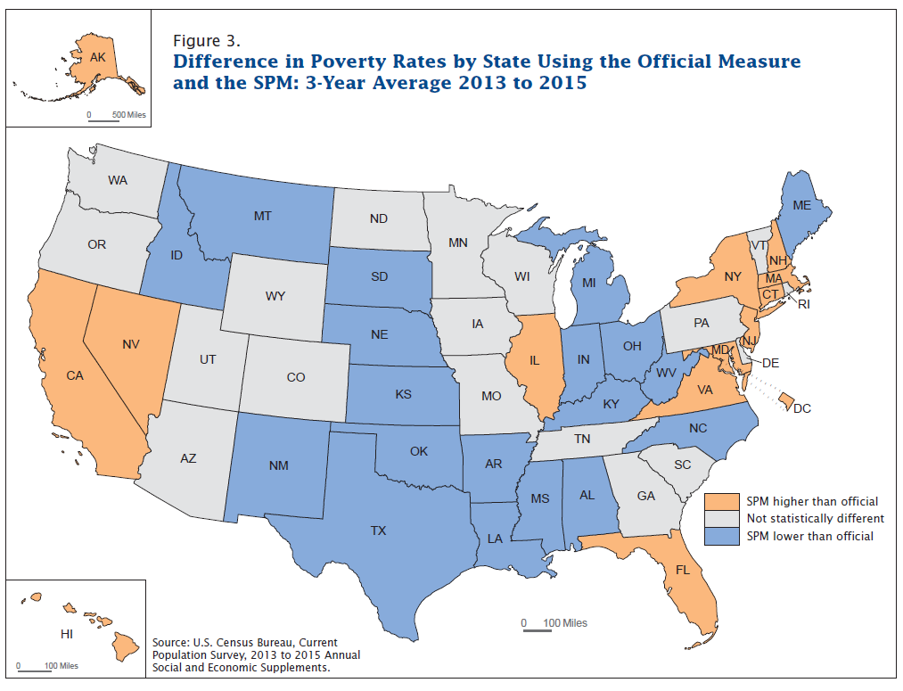

Slide 23
When to Use ACS- CPS Data
In general national level estimates from both surveys are consistent and comparable, most of the differences are not statistically significant
It is recommended to use the CPS estimates at the national level
State level estimates in general are similar and no systematic differences observed,
For use at state and lower geographic levels ACS estimates are recommended

Slide 24
Why Try to Implement the SPM in the ACS?
CPS ASEC sample not large enough for
single year state level poverty estimates
substate poverty estimates, e.g. metro area
Researchers across country using the ACS to estimate SPM-like measures
New York City, Wisconsin, Urban Institute, New York State, Philadelphia, San Francisco, California, Virginia
interest in production of comparable estimates
provide estimates for jurisdictions not able to fund their own research operations

Slide 25
Challenges when implementing the SPM using the ACS
Unit of analysis – ACS does not identify unrelated subfamilies
Thresholds
Inflation adjustment
Geographic unit for cost of living adjustment
Resources
Noncash benefits
Necessary expenditures
Taxes
Childcare and other work-related expenses
Medical out-of-pocket expenses

Slide 26
Unit of Analysis
IPUMs rules used to assign relationship codes to unrelated individuals – creating unrelated subfamilies to be grouped together for calculating taxes and poverty status and adding cohabiting partners and their relatives to the householder’s resource unit
uses age, marital status, and the order in which individuals are listed on the ACS form to assign the pointers
Very few unrelated subfamilies – 375,000
reduces the number of unrelated individuals from 48.5 million to about 44 million
Thresholds
Translated MSAs to PUMA level to adjust for geographic differences in the cost of living
Used an average calendar year threshold and adjusted income

Slide 27
Data on Noncash Benefits: CPS vs. ACS
NONCASH Benefit | CPS ASEC |  | ACS
 | Participation | Amount | Participation | Amount
SNAP – Supplemental Nutrition Assistance Program | YES | YES | YES | NO
WIC - Women, Infants and Children Nutrition Program | YES | NO | NO | NO
Regular School Lunch | YES | NO | NO | NO
Free or Reduced Price School Lunch | YES | NO | NO | NO
Housing Assistance | YES | NO | NO | NO
LIHEAP – Low Income Home Energy Assistance Program | YES | YES | NO | NO

Slide 28
Data on Necessary Expenditures
Necessary Expenditures | CPS ASEC | ACS
Taxes | NO | NO
Child Care | YES | NO
Medical Out of Pocket (MOOP) | YES | NO
Child Support Paid | YES | NO

Slide 29
Comparing CPS and ACS Poverty Estimates
Official poverty estimates from the two sources are not identical
Different reference periods
ACS less detailed income reporting
SPM poverty estimates also impacted by:
Lack of relationship pointers
Imprecise imputations
Poverty rates shown here are preliminary

Slide 30
2011 Official Poverty Rates: CPS vs ACS

Slide 31
2011 SPM Poverty Rates: CPS vs ACS

Slide 32
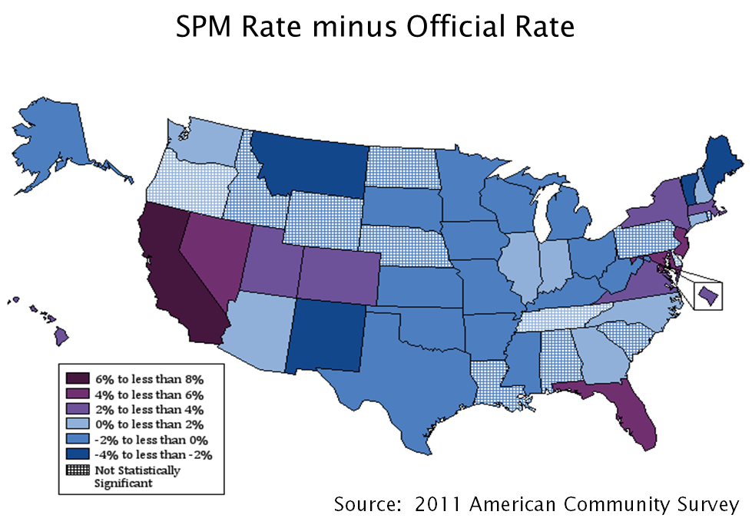
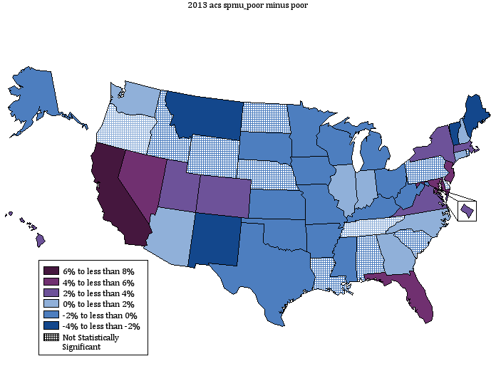
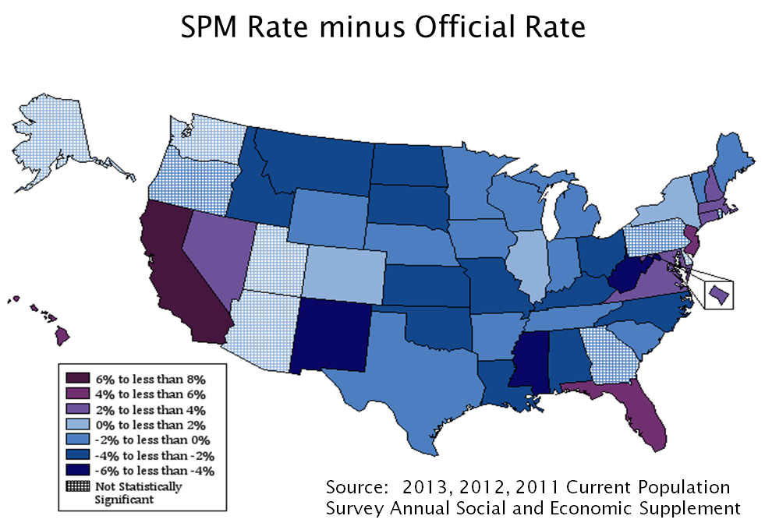
How do State Poverty Rates Using the SPM Compare to the Official Poverty Rates?

Slide 33
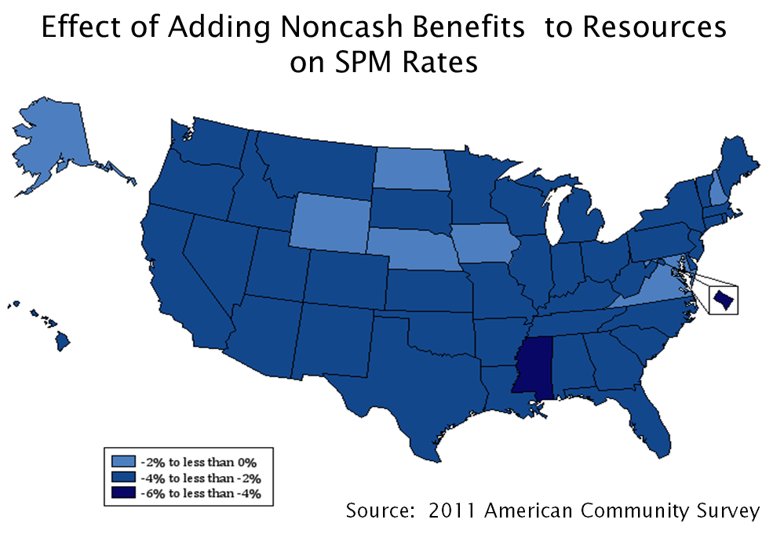
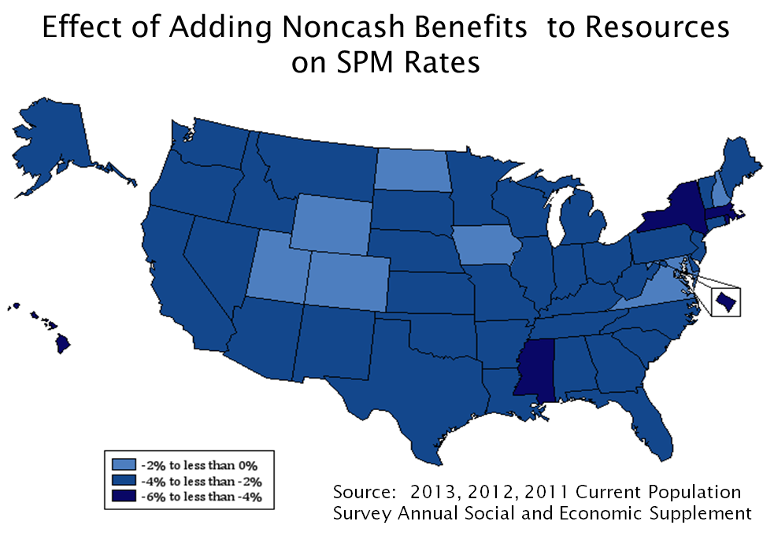
How Much do Noncash Benefits Decrease SPM Rates?

Slide 34
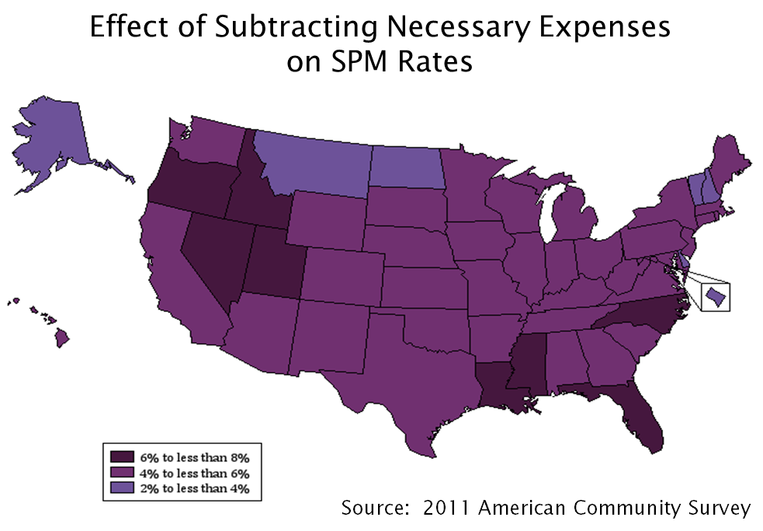
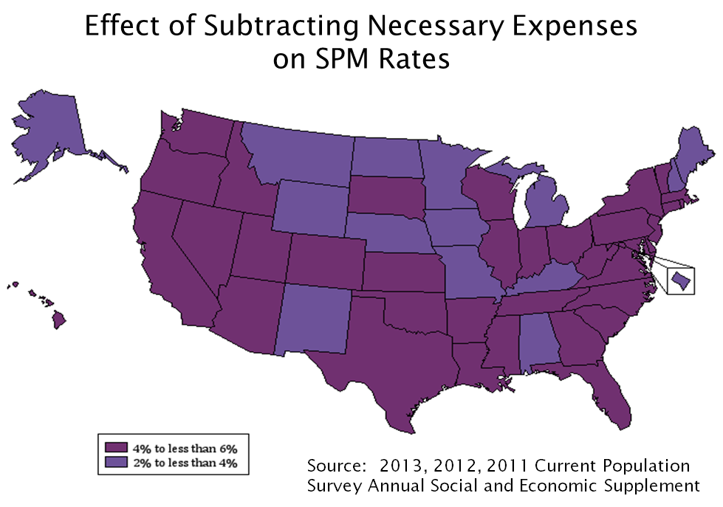
How Much do Necessary Expenses Increase SPM Rates?

Slide 35
Comparing ACS, CPS ASEC and State Specific SPM Estimates: 2011
Sources: The Stanford Center on Poverty and Inequality, the Weldon Cooper Center for Public Service, University of Virginia, Institute for Research on Poverty and the NYC Center for Economic Opportunity

Slide 36
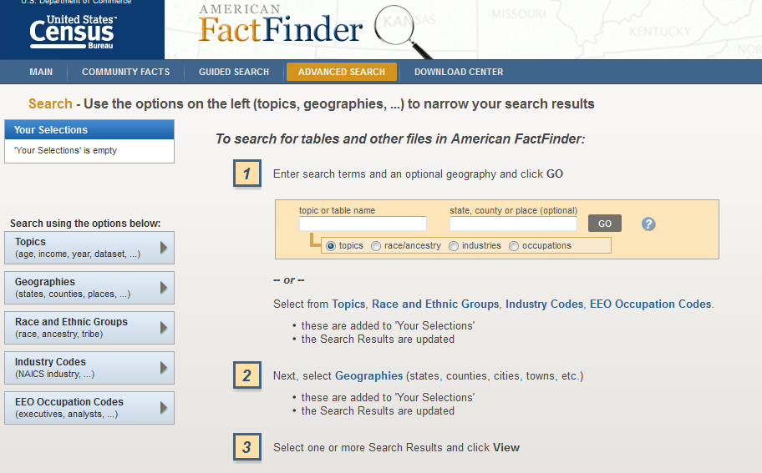
How to Find ACS data on American Factfinder (AFF)
From main Census Web page (www.census.gov)
Click on ‘Data’ then ‘Data Tools and Apps’
Select ‘The American Factfinder’
From The American Factfinder page
Click on ‘Topics’ to choose the subject
Click on ‘geography’ to choose geographic area then click “ADD”
Make sure your selection is showing in the “selection box”
Close geographic selection screen
Select ‘ the table ’ and click “VIEW”
Make sure to the choose the correct dataset (1-year, 3-year, 5-year estimates)

Slide 37
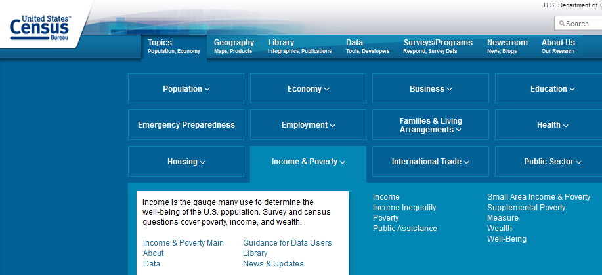
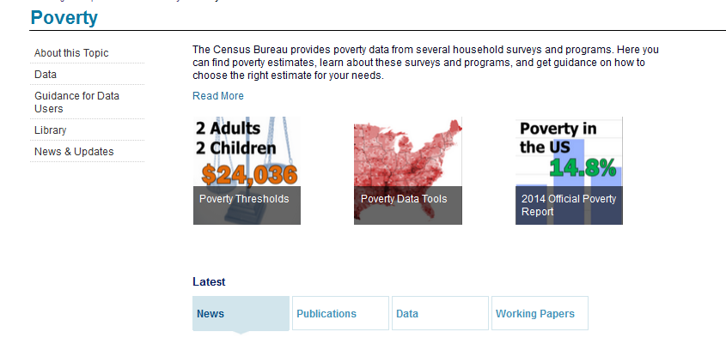
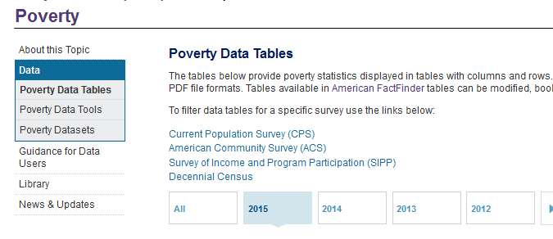
How to Find CPS Data
From the main Census Bureau page (www.census.gov)
Sequentially click on - ‘Topics’ , ‘Income & Poverty’ and ‘Poverty’ or
Go directly to the poverty page using (http://www.census.gov/topics/income-poverty/poverty.html)
From the poverty page click on ‘Data’ and then Poverty Data Tables

Slide 38
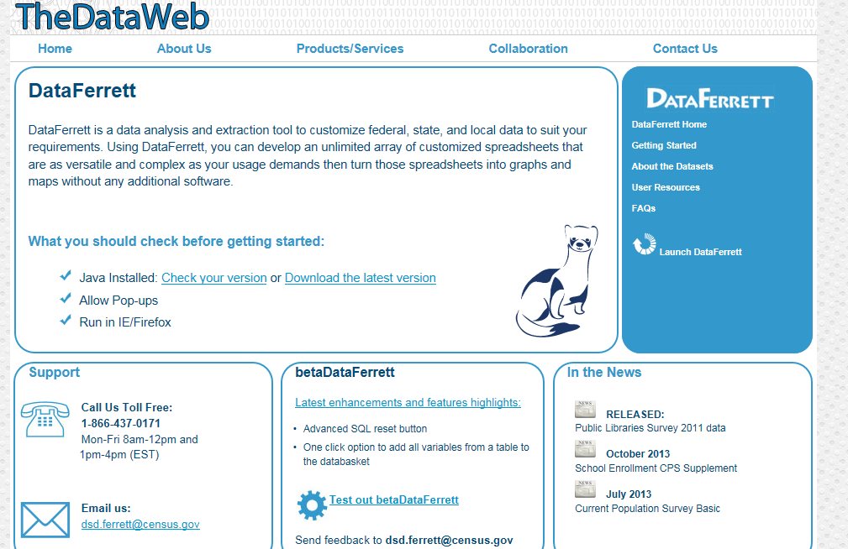
http://dataferrett.census.gov/

Slide 39
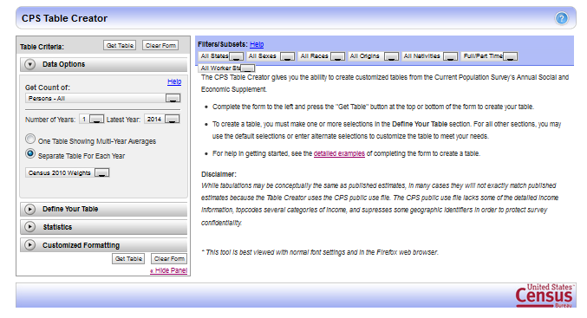
http://www.census.gov/cps/data/cpstablecreator.html

Slide 40
Understanding the Supplemental Poverty Measure
Trudi Renwick
Trudi.j.renwick@census.gov
301-763-5133
Liana Fox
Liana.e.fox@census.gov
301-763-2676
http://www.census.gov/hhes/povmeas/index.html

Slide 41
EXTRA SLIDES

Slide 42
Official and SPM Thresholds: 2014 and 2015

Slide 43
Official and Research SPM Thresholds for Two Adult, Two Child Units with Geographic Adjustments: 2015

Slide 44
Comparison of SPM and Official Poverty Estimates by Race and Hispanic Origin: 2015
Percent
Official*
SPM
*Includes unrelated individuals under age 15.
Source: U.S. Census Bureau, Current Population Survey, 2015 Annual Social and Economic Supplement.
www.census.gov/library/publications/2015/demo/p60-254.html

Slide 45
Comparison of SPM and Official Poverty Estimates by Nativity: 2015
Percent
Official*
SPM
*Includes unrelated individuals under age 15.
Source: U.S. Census Bureau, Current Population Survey, 2015 Annual Social and Economic Supplement.
www.census.gov/library/publications/2015/demo/p60-254.html

Slide 46
OPM Resources
Earnings
Unemployment compensation
Workers' compensation
Social Security
Supplemental Security Income
Public assistance
Veterans' payments
Survivor benefits
Pension or retirement income
Interest, dividends, rents, royalties, income from estates, trusts, educational assistance, alimony, child support, assistance from outside the household, and other miscellaneous sources.

Slide 47
SPM Resources
Adjust cash income in CPS ASEC with:
- In-kind benefits:
SNAP/Food stamps
Energy subsidies/LIHEAP
Housing subsidies
School lunch
WIC
Subtract:
Tax liabilities/credits
Work expenses and child care
MOOP
Child support paid

Slide 48

Current Population Survey (CPS)
Produce specific socioeconomic and demographic estimates for the United States and states for total population and selected subpopulations.
With the Annual Social Economic Supplement (ASEC), provide timely estimates of income and health insurance, as well as official poverty estimates.
Annual sample size is about 100,000 addresses.
Telephone and personal-visit interviews for the 50 states and the District of Columbia. The CPS is a voluntary survey.

Slide 49
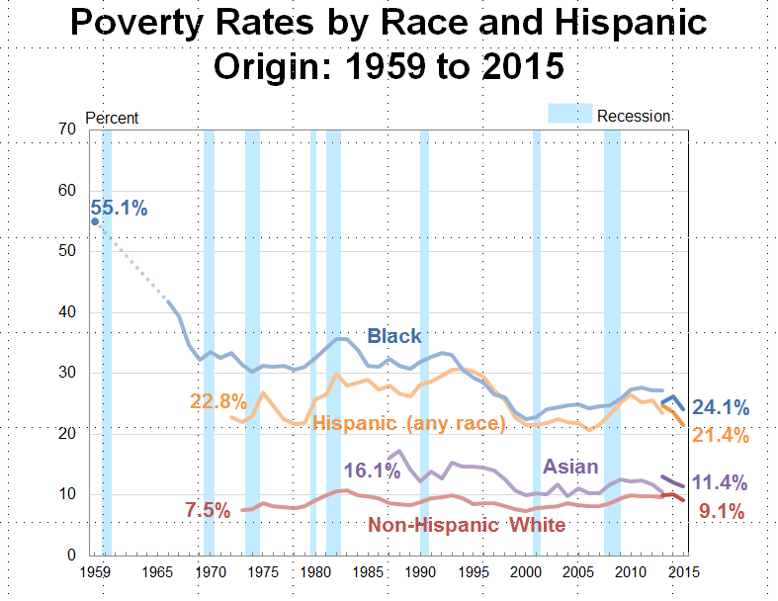
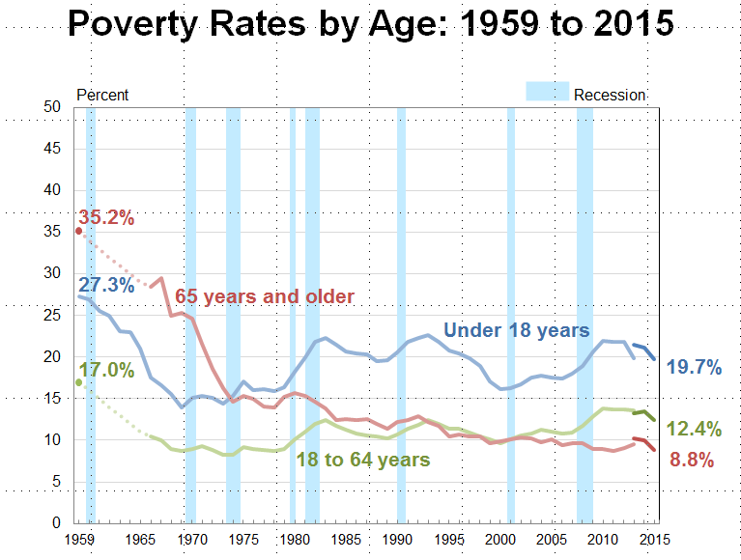
CPS ASEC asks a series of 50 questions about various sources of income, including questions about the amount of several noncash benefits such as food stamps and employment-related health insurance, during the previous calendar year.
Interviews conducted between February-April, asks about last calendar year income.
Unrelated subfamilies are identified and poverty status is determined as a family
Rich historical data
For characteristics of U.S. population – since 1959
For state level – since 1980

Slide 50
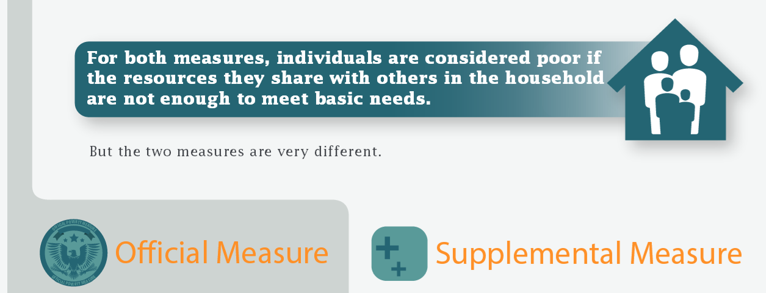

Slide 51
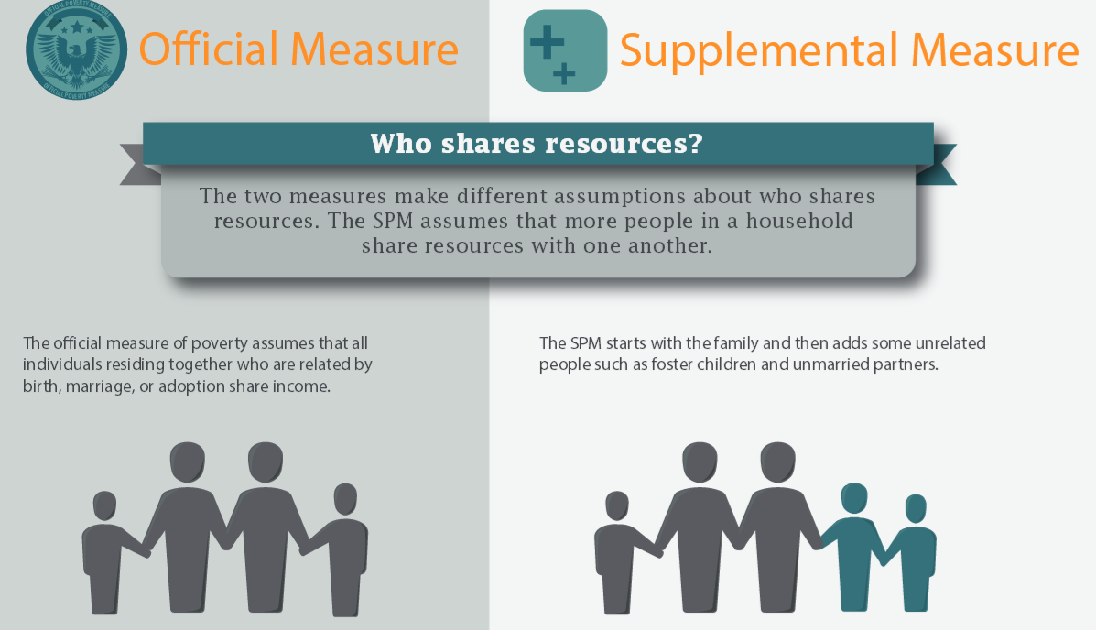

Slide 52
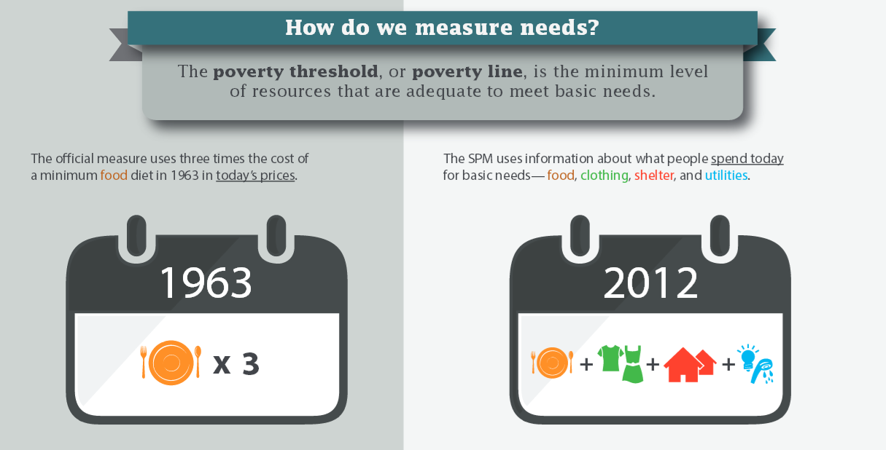

1963
2015

Slide 53
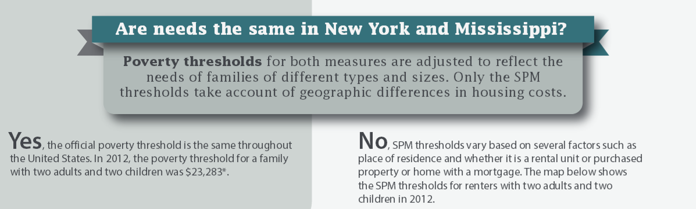
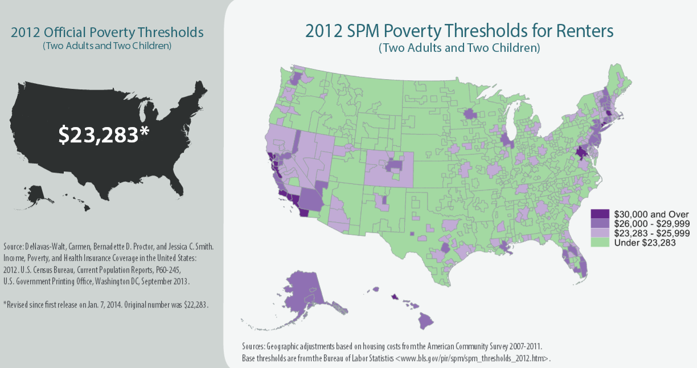
Notes:
Threshold adjustments
Vary by family size, composition and age of householder
Geographic adjustments for differences in housing costs and equivalence scale for family size and comp. Three separate thresholds by housing status

Slide 54
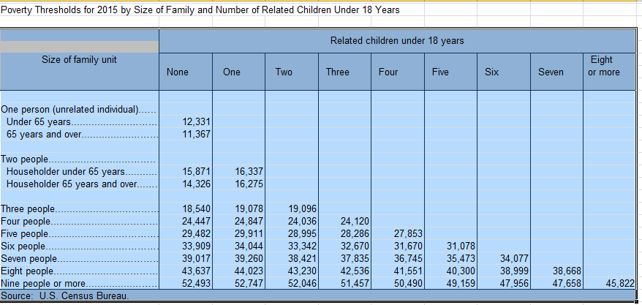
2015 Official Thresholds

Slide 55
2015 SPM Thresholds

Slide 56
